Slide 1
Demographics & Economics of Aging in California California Commission on Aging: Elder Economic Forum
Steven P. Wallace, PhD
Professor, UCLA School of Public Health
Director, Resource Centers for Minority Aging Research (RCMAR) Coordinating Center
Associate Director, UCLA Center for Health Policy Research
swallace@ucla.edu
Notes:
15 min - overview of the increasingly diverse demographics of the 65+ population across the nation. I addition he and his UCLA staff lead the number crunching in California for the Elder Index. So this time around I’d like him to briefly explain that and then also talk about housing costs as a prime example of the economic stressors that make it hard for seniors to make ends meet with incomes 2-to-3 times the FPL (mainly from housing variations from urban counties to rural ones). He’ll specifically refer to his office’s recent look at the rent burden on seniors in Calif. ~ 15-18 min

Slide 2
3 take home points
The state is becoming older & more racially & ethnically diverse
Diverse older adults face economic insecurity
Economic insecurity is caused by, and contribute to, housing problems
Look to policy on Social Security, pensions, & Medicare in the future

Slide 3
1. The state is aging & becoming more diverse

Slide 4
Population Growth, Age 65+, California, 2010-2060
51.0
Source: California Department of Finance, 2016, P-3 database
http://www.dof.ca.gov/Forecasting/Demographics/Projections/
Notes:
# older adults 2010 – 2030 DOUBLES, by 2060 TRIPLES
11.5% total pop to 26.4%!
ACTUAL, DOF total pop and ACS 2017 % = 2019 >5.5 million (14%) of ~40 million population

Slide 5
Fastest Growth, Elders of Color
Source: California Department of Finance, 2016, P-3 database
http://www.dof.ca.gov/Forecasting/Demographics/Projections/
Notes:
3 STORIES – growth elderly, rainbow in gray, Latino growth
Boomer Generation hits in 2011 … total # =

Slide 6
Growing Diversity of Elderly in California
Source: California Department of Finance, 2016, P-3 database
http://www.dof.ca.gov/Forecasting/Demographics/Projections/
Notes:
Currently a mostly nonLatino white population, but following the rest of the state population it is increasingly diverse.
2000 from: California Department of Finance, July 2007 www.dof.ca.gov/HTML/DEMOGRAP/ReportsPapers/Projections/P3/P3.asp

Slide 7
2. Diverse older adults face economic insecurity

Slide 8
Aren’t all CA seniors well to do?
10.5% are under federal poverty line in 2018, lower than nonelderly adults (10.6%) and children (16.4%)
Source: Current Population Survey, 2019
Notes:
IMAGE of “the elderly” is well off, going on cruises, having the good life
In CA, the top 5% of older adults have a MEDIAN family income of $243,000
The BOTTOM *half* have a median income <$48,000 vs $72,600 for families under 65.
Bottom 20% have family incomes under $20,400; almost all below 150% FPL (88%)
http://www2.census.gov/programs-surveys/demo/visualizations/p60/256/figure5.pdf
https://www.cruisecritic.com/articles.cfm?ID=1704

Slide 9
Poor and near poor, Age 65 & Over, California, 2018
Note: white, Asian & black are nonLatino; Latino is any race; AIAN includes multiple race/ethnicity
Source: Current Population Survey 2018 http://www.census.gov/cps/data/cpstablecreator.html
Notes:
Note the large groups right above the FPL!

Slide 10
The Problem: Federal Poverty Guideline
… no longer provides an accurate picture of the differences in the extent of economic poverty among population groups or geo-graphic areas of the country, nor an accurate picture of trends over time.... (National Research Council, 1995, page 1)
Notes:
… has remained virtually unchanged over the past 30 years. Yet during that time, there have been marked changes in the nation’s economy and society
Me: outdated, inaccurate, and inadequate

Slide 11
FPL same amount everywhere $12,490 (1-person 2019)
https://aspe.hhs.gov/poverty-guidelines
Notes:
Problem #2 – only one # nationally, exc. Alaska & Hawaii
2018 Guidelines, ASPE; 2=$16,910

Slide 12
Housing Costs Vary Geographically HUD Fair Market Rents, 2019 1-br apartment
San Francisco, CA $2,255
Boston, MA $1,801
New York, NY $1,599
Los Angeles, CA $1,384
Portland, OR $1,134
Minneapolis, MN $ 915
Fresno, CA $ 769
Brownsville, TX $ 563
Source: https://www.huduser.gov/portal/datasets/fmr.html
Notes:
Primary driver of regional differences in cost of living.
Portland = Multnomah County
Houston, TX $ 907

Slide 13
Distribution of household expenditures, 2018
Source: 2018 Consumer Expenditure Survey https://www.bls.gov/cex/tables.htm
Notes:
Problem #4 – seniors spend different than younger adults
REMEMBER – FPL is based on 3x food costs from 60 years ago. NOW health care and housing both consume more than food in budgets. (no other category alone >10%), includes clothing, entertainment, personal care products, phone, etc.
Note also that in the 1950’s, as little as 26% of family budgets went for housing, while about one-third went for food.

Slide 14
Better Alternative: Elder Economic Security Standard index (Elder Index)
For counties
Based on actual costs (needs) of basic necessities for older households: housing, food, transportation, health care, and other costs
Uses unadjusted income
Current data
See: www.healthpolicy.ucla.edu/ElderIndex

Slide 15
Elder Standard Index 2017 LA City & Humboldt County (FPL=$12,060)
Monthly Expenses | Los Angeles City |  | Humboldt County
 | Owner w/o Mortgage | Renter, One Bedroom | Owner w/o Mortgage | Renter, One Bedroom
Housing | $600 | $1,177 | $377 | $769
Food | 266 | 266 | 259 | 259
Transportation | 222 | 222 | 222 | 222
Health Care=Good | 168 | 168 | 446 | 446
Miscellaneous | 250 | 250 | 259 | 259
Elder Index /Month | $1,506 | $2,083 | $1,563 | $1,955
Elder Index Per Year | $18,072 | $24,996 | $18,756 | $23,460
Note: Numbers may not add up to total due to rounding.
Notes:
Humboldt costs MORE for owner w/o mortgage because of higher HEALTH CARE costs. RENTER higher in LA.
Health care costs are higher than rent for couples in 16 California counties where HMOs are not common.
REMEMBER – elders of color about 2x more likely to be under 200% FPL; FASTEST GROWING population

Slide 16
The impact of housing costs
Moderate = 30-49% of income spent on housing
Severe = 50% or more
https://www.huduser.gov/portal/pdredge/pdr_edge_featd_article_092214.html
Notes:
Not much research on elder homelessness. Most takes an individual risk approach – drug abuse, MH probs, IPV, family conflict, low human capital (e.g. ed), landlord problem approach. Few look at the CONTEXT, tho one study in NY found those living in subsidized housing were less like to become homeless (1998: Predictors of homelessness among families in New York City: from shelter request to housing stability. http://ajph.aphapublications.org/doi/abs/10.2105/AJPH.88.11.1651. )

Slide 17
% Renters, Age 65+, US&CA 2017
Source: 2017 American Community Survey
Notes:
Noninstitutionalized population

Slide 18
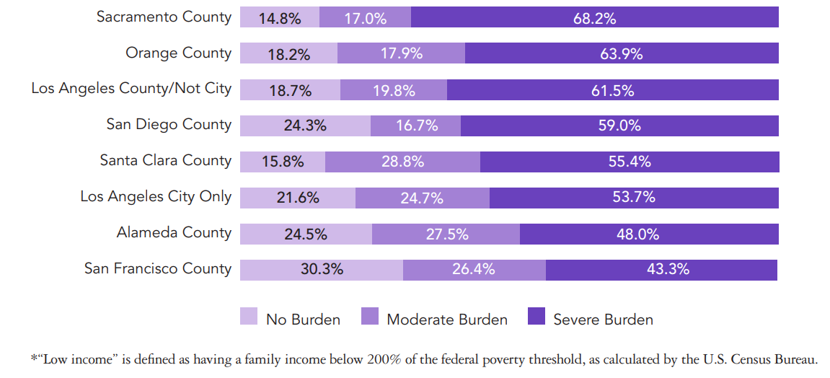
Rent-burdened low-income* Californians, Age 65+, 2016
http://healthpolicy.ucla.edu/publications/Documents/PDF/2018/RentBurdened-factsheet-aug2018.pdf

Slide 19
Years living in current home, Households w/Head Age 65+, CA
Source: 2017 American Community Survey, noninstitutionalized population
Notes:
RENTERS (almost half of all low-income seniors; one-quarter all elders; 16% >200% FPL) are the least housing stable. They have little control over the costs of housing compared to owners.
So, econ insecurity is associated with rent burden
Interestingly, the distribution does not change much with income OR race/ethnicity OR rent burden!
Litwak and Longino's (1987): amenity moves, assistance moves; Longino (2008) adds community & personal ties & notes non-owners more likely to move

Slide 20
Consequence of forced move?
Weakened social networks
Disrupted health care relationships
Possible decline in access to community services
Notes:
Social networks key to health
In CCI, primary reason to NOT enroll was to keep current providers

Slide 21
3. Policy on income security
Notes:
Credit – Getty Images

Slide 22
Sources of income, Age 65+, 2014
Source: http://www.agingstats.gov 2016

Slide 23
Chained CPI will worsen gap
+2%
Source: AARP
www.aarp.org/work/social-security/info-10-2012/proposed-changes-to-cola-insight-AARP-ppi-econ-sec.html
Notes:
CPI – market basket of goods (X steak, Y chicken, Z fish); Chained CPI tracks substitution (beef up, eat more chicken. Chicken up, eat more ??)
Table starts with average retirement benefit. Assumes an annual COLA (based on CPI-W) of 2.8%. Benefits are adjusted into real dollars using the CPI-W (CPI for Urban Wage Earners). NOT reflect elder spending ~ FPL.
CPI-U includes retired persons, self-employed workers, professionals, and unemployed—groups not currently captured by CPI-W. Introduced 1978 and used for annually adjusting tax code and poverty thresholds for inflation. It represents the spending patterns of about 87% of the total U.S. population.
CPI-E is calculated by re-weighting the “expenditure categories” in the CPI-U to reflect the average expenditures of people age 62 and over. (past 30 years rises about 0.27% faster than CPI-W).
Starting 1999 the CPI included substitution WITHIN each of 211 items in market basket; e.g. Braeburn for Fuji apples. The CHAINED CPI allows for substitution between categories. If beef prices rise, consumers buy chicken (and if chicken is too expensive, switch to dog food?). Poor people may already be at bottom of substitution, so little flexibility. (rises about 0.3% slower than CPI-W). = “death by a thousand cuts” for those already economically insecure!

Slide 24
Improve SSI
CA adds food stamps https://www.justiceinaging.org/ssi-in-california/
CA has not yet restored cuts from recession
Notes:
The budget does not include any increase in the State Supplemental Program for SSI recipients either for a restoration of a COLA in the budget year or a restoration of the reductions made in 2009. https://www.disabilityrightsca.org/legislation/summary-of-the-governors-proposed-budget-for-2019-20-impacting-persons-with

Slide 25
CalSavers Retirement Savings Program
https://www.calsavers.com/
Notes:
Starting in July 2019, California began offering an estimated 7 million workers in California^{[1]} the opportunity to contribute to an Individual Retirement Account (IRA) and get on track for the future.

Slide 26
Conclusion
Elders of color are a growing segment of the older population
Economic security is most challenging for all, but esp. elders of color
Housing costs are a burden
Public policy can help or hurt future cohorts

Slide 27
Thank you
www.healthpolicy.ucla.edu

